Slide 1
OO JavaScript Review Objects, ‘this’, JSON, Closures, Promises
The Underpinning Language
Welcome
Prof. James Mwangi

Slide 2
Lesson Objectives
Assignment 3
Creating Objects (Object Literal)
Creating Objects (Function Closures)
Creating Objects (Function Constructors)
‘this’ keyword
Prototypal Inheritance
var, let, const
Exception handling/Throwing Errors
Promises – Resolve & Then || Reject & Catch | Chaining Promises
Arrow Function, Lexical ‘this’

Slide 3
Creating Objects (Object Literal)
Persons psn1 ps2 ps3 ps4 ps5
name: John Mary Ruth Mike Hassan
age: 23 25 21 29 34
employer: rbc cibc bmo aircan cbc
undergrad: uoa uot uot wu ubc
Property
Value

Slide 4
Create an object, Add two set methods
var person = {name : 'john’,
salary : 1500,
employer : 'rbc’,
undgrad : uot,
};

Slide 5
Exercise
Create an object called Plumber with the following properties:
Lname (string)
yearsofexperience (number)
occupation (string)
and methods…
setYrsOfExp (a “setter” to set a new value for the “yearsofexperience” property)
setLname (a “setter” to set a new value for the “Lname” property)

Slide 6
Exercise Solution
var person = {'name':'john', 'age': 23, 'employer': 'rbc', 'undgrad': uot };
var Plumber = {name: "John",
YearsOfExperience: 45,
occupation: "Plumber",
SetYearsOfExperience: function(newExp){this.YearsOfExperience = newExp},
setName: function(newName){this.name = newName}
};

Slide 7
Creating Objects – Function Closures
A closure is the combination of a function and the lexical environment within which that function was declared.
https://developer.mozilla.org/en-US/docs/Web/JavaScript/Closures

Slide 8
Lexical Scoping
function init() {
var coursename = WEB322'; // name is a local variable created by init
function displayName() { // displayName() is the inner function, a closure
alert(coursename); // use variable declared in the parent function
}
displayName();
}
init();

Slide 9
Exercise
Create and run the code in previous slide
NOTE:
The word "lexical" refers to the fact that lexical scoping uses
the location where a variable is declared within the source code
to determine where that variable is available.
Nested functions have access to variables declared in their outer scope.

Slide 10
Prototypal Inheritance
See details here;
https://developer.mozilla.org/en-US/docs/Learn/JavaScript/Objects/Object_prototypes

Slide 11
Creating Objects using JSON see Demo Code on Blackboard
//Here’s a JSON string we can use to create objects
var jsonstringdata= { "employees":[ {"firstName":“Jake", "lastName":“Benard"}, {"firstName":“Susan", "lastName":“Baker"}, {"firstName":“David", "lastName":“George"} ] }
var newobj = JSON.parse(jsonstringdata);

Slide 12
JSON data
var studata = '{"students":[' +
'{"FName":"James","LName":"Lincon" },' +
'{"FName":"Esther","LName":"Luvian" },' +
'{"FName":"Harsh","LName":"Micar"}]}';
/* Create a JSON string for Programs with appropriate name.
progName can be CPA, CPD, BSD, IFS
DoG can be Winter 2018, Spring 2018, Fall 2018
Display all students, full names the courses
they take and their possible dates of graduation
*/

Slide 13
Closure
A closure is created
whenever a function returns another function, or an object containing functions
A closure is the combination of a function and the lexical environment within which that function was declared.
This environment consists of any local variables that
were in-scope at the time the closure was created.

Slide 14
Closure
function makeFunc() {
var coursename = WEB322';
function displayName() {
alert(coursename);
}
return displayName;
}
var myFunc = makeFunc();
myFunc();

Slide 15
Closures
makeFunc() finishes executing, but the name variable remains accessible
This is because functions in JavaScript form closures.
A closure is the combination of a function and the lexical
environment within which that function was declared.
This environment consists of any local variables that
were in-scope at the time the closure was created.
In this case, myFunc is a reference to the instance of the
function displayName created when makeFunc is run.
The instance of displayName maintains a reference
to its lexical environment, within which the variable name exists.
For this reason, when myFunc is invoked,
the variable name remains available for use and “WEB322" is passed to alert.

Slide 16
Closure
An Interesting Scenario for returned functions
– JavaScript actually executes the returned function within the scope of the containing function,
which means that the returned function has access to the local variables of the function in which it was defined.

Slide 17
Closures: Example 2
function counter(){
var localCounter = 0; // declare "localCounter" within the "counter()" function scope
return function(){ // return a new function that references "localCounter"
localCounter++; // increment it by 1
return localCounter; // return the value of "localcounter"
};
}
// call the counter() function and get a reference to the new function
var count = counter();
// call the new function
console.log(count());
console.log(count());
console.log(count());

Slide 18
Closures: Example 3
function makeAdder(x) {
return function(y) {
return x + y;
};
}
// name the two closure and their function factory
var add5 = makeAdder(5);
var add10 = makeAdder(10);
console.log(add5(2));
console.log(add10(2));

Slide 19
Promises
What is a Promise?
States of a Promise.
Syntax of a promise
Chaining Promises

Slide 20
Executor : What is It?
executor
Is A function that is passed with the arguments resolve and reject.
The executor function is executed immediately by the Promise implementation, passing resolve and reject functions (the executor is called before the Promise constructor even returns the created object).
The resolve and reject functions, when called, resolve or reject the promise, respectively.

Slide 21
Promise - Defined
The Promise object represents the eventual completion (or failure) of an asynchronous operation, and its resulting value.
A Promise is a proxy for a value not necessarily known when the promise is created.
It allows you to associate handlers with an asynchronous action's eventual success value or failure reason. This lets asynchronous methods return values like synchronous methods: instead of immediately returning the final value, the asynchronous method returns a promise to supply the value at some point in the future.

Slide 22
States of a Promises
pending: initial state, neither fulfilled nor rejected.
fulfilled: meaning that the operation completed successfully.
rejected: meaning that the operation failed.
See a Promise graphically: source: developer.mozilla.org in the next slide

Slide 23
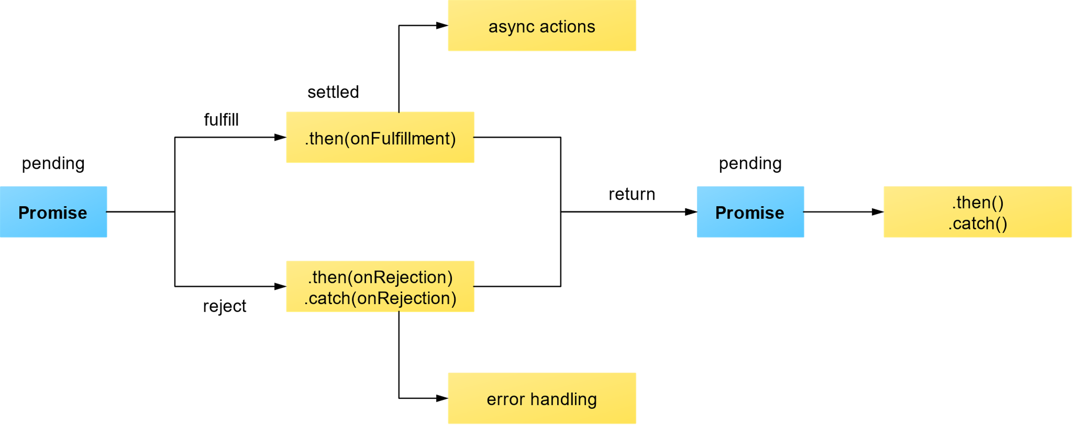

Slide 24
Syntax of a Promise
new Promise( /* executor */ function(resolve, reject) { ... } );

Slide 25
Creating a Promise
const myFirstPromise = new Promise((resolve, reject) => {
// do something asynchronous which eventually calls either:
//
// resolve(someValue); // fulfilled
// or
// reject("failure reason"); // rejected
});

Slide 26
Example:
Example by Jecelyn Yeen
https://scotch.io/tutorials/javascript-promises-for-dummies
See examples at the end of :
https://developer.mozilla.org/en-US/docs/Web/JavaScript/Reference/Global_Objects/Promise

Slide 27
Advanced JavaScript Objects
Week 4
Prof. James Mwangi

Slide 28
Lesson Takeaway
Closure
Arrow Functions
Promises
Serving up JSON content

Slide 29
Create the directories below
closures
arrowfunctions
promises
servejson

